Slide 1


Fighting Game
By Gregory Richter and Nir Bekker

Slide 2
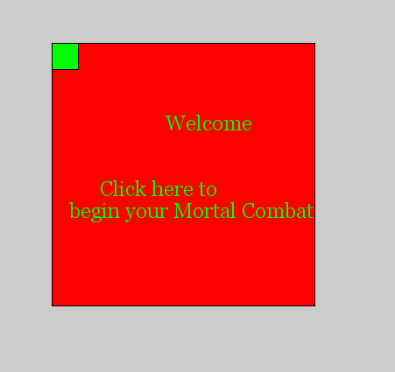

Slide 3
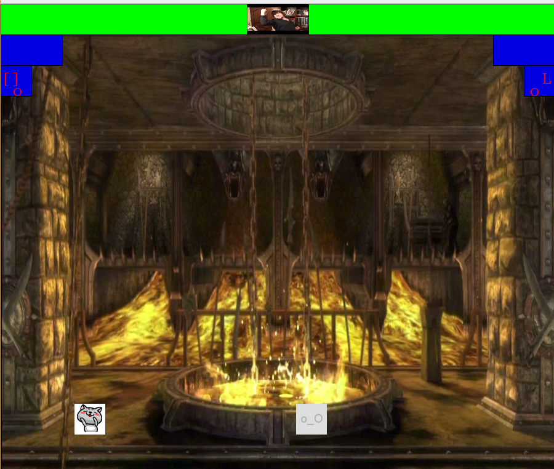
Overview
2-d Fighting Game
Contents:
2-D Movement
Punch, Block, Kick
Images
Health Bar
Special Attack with Mana
Bullet

Slide 4
Demo

Slide 5
Classes

Slide 6
Player
Build the player and his possible movement in the 2-d arena
Gravity, movement
Collision Detection
Their CQC (Close quarter combat) Attacks and Blocks

Slide 7
Health Bar
The size of the bar is created
Done this way in order to move its x value when damage received

Slide 8

Bullet
We deal with the basic properties of the players’ projectiles
Speed
Collision with players
Constant size of projectile

Slide 9
Ability
We use this to help deal with our projectile
Incorporates the cool down
Time

Slide 10

MP3
This class allows us to have background music
Called in main class to begin playing

Slide 11
Main Class

Slide 12
The Setup
We load all of our images and save them into their corresponding new “variables”
The MP3 is played here

Slide 13
Draw
Everything is culminated here
All of the images are loaded
In addition to the in game view console plays a role
Displays projectile coordinates and if they hit
Says the winner at the end
Projectiles added and shown

Slide 14

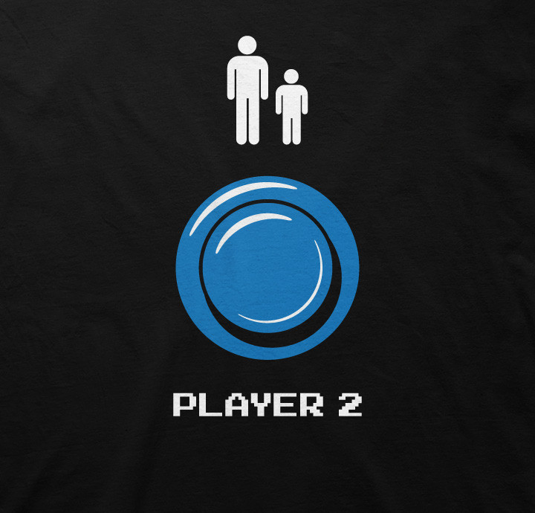
Our Controls

Slide 15
For Player 1:
W = Jump
A = Left
D = Right
X = Block
Q = Punch
E = Kick
Space Bar = Bullet
For Player 2:
Left Arrow = Left
Right Arrow = Right
Up Arrow = Jump
1 = Punch
2 = Block
3 = Kick
L = Bullet

Slide 16
Idea behind layout
Assuming the players are playing off of the same computer
P1 has controls on left
P2 uses the right of keyboard (Assuming have numpad)

Slide 17
Mana
Principle behind this is to prevent projectile spam
Combination of both a mana limit and cool down for use
Regenerates

Slide 18
With more time
Look to polish everything as a whole much better
More appealing start menu
Add more color depth to the health bar
Green -> Red as damage is received
Characters more fluent
Make movement seem more fluid

Slide 19
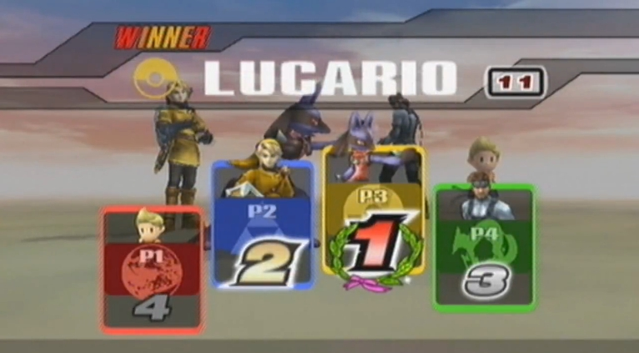
Thank you

